Slide 1
Level 6 Group 9 Pitch 2
Thomas Simmons, Blake Hewitt, Quwaine Dantes - McPherson, Callam Mutton

Slide 2
Summary of Brief
We want to create a game that allows the player to care about something, thus using emotional empathy
We decided to use the emotions love and joy along with their secondary and tertiary emotions to create the right emotional responses we want through the use of empathy.
QD

Slide 3
Target Audience/Demographic
20 to 29 year olds who carried the original Tamagotchi toys to school in the late '90s.
49% of casual players aged 25-34 spend money on games
54% of casual players aged 13-24 don’t spend on games but spend more time playing the game
TS

Slide 4
Game Idea
A nurturing based game where the player has to manage the pet’s needs, which are:
Joy/Happiness
Love
Thirst
Hunger
BH

Slide 5
Pet Traits Detailed
The traits are influenced in the following ways:
Love mainly increases from player interaction
When hunger increases, thirst decreases
When hunger and thirst increase, so does happiness slightly.
When hunger and thirst decrease, so does happiness slightly.
When happiness decreases so does love slightly.
All attributes decrease over time.
BH

Slide 6
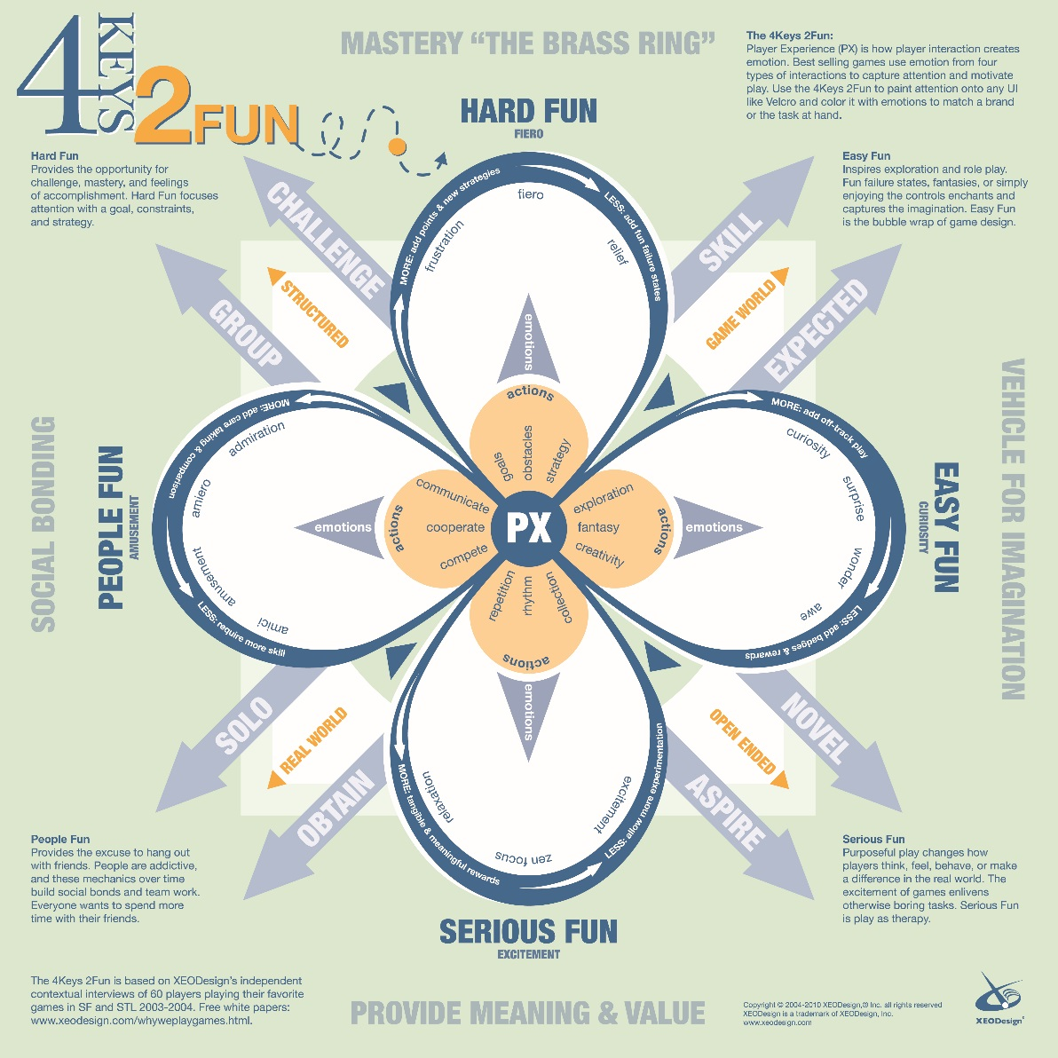
Keys of Fun
We will want to implement elements of serious, social and people fun into the game. The reason for this is elements of these aspects of the keys of fun can be used in tandem to make a game that can be enjoyed by a multitude of people
QD

Slide 7
Core Game Loop
Check Traits
Check Resources
Interact with pet
QD

Slide 8
Player Reward
Major reward is the pet becoming more attached to the player
TS

Slide 9
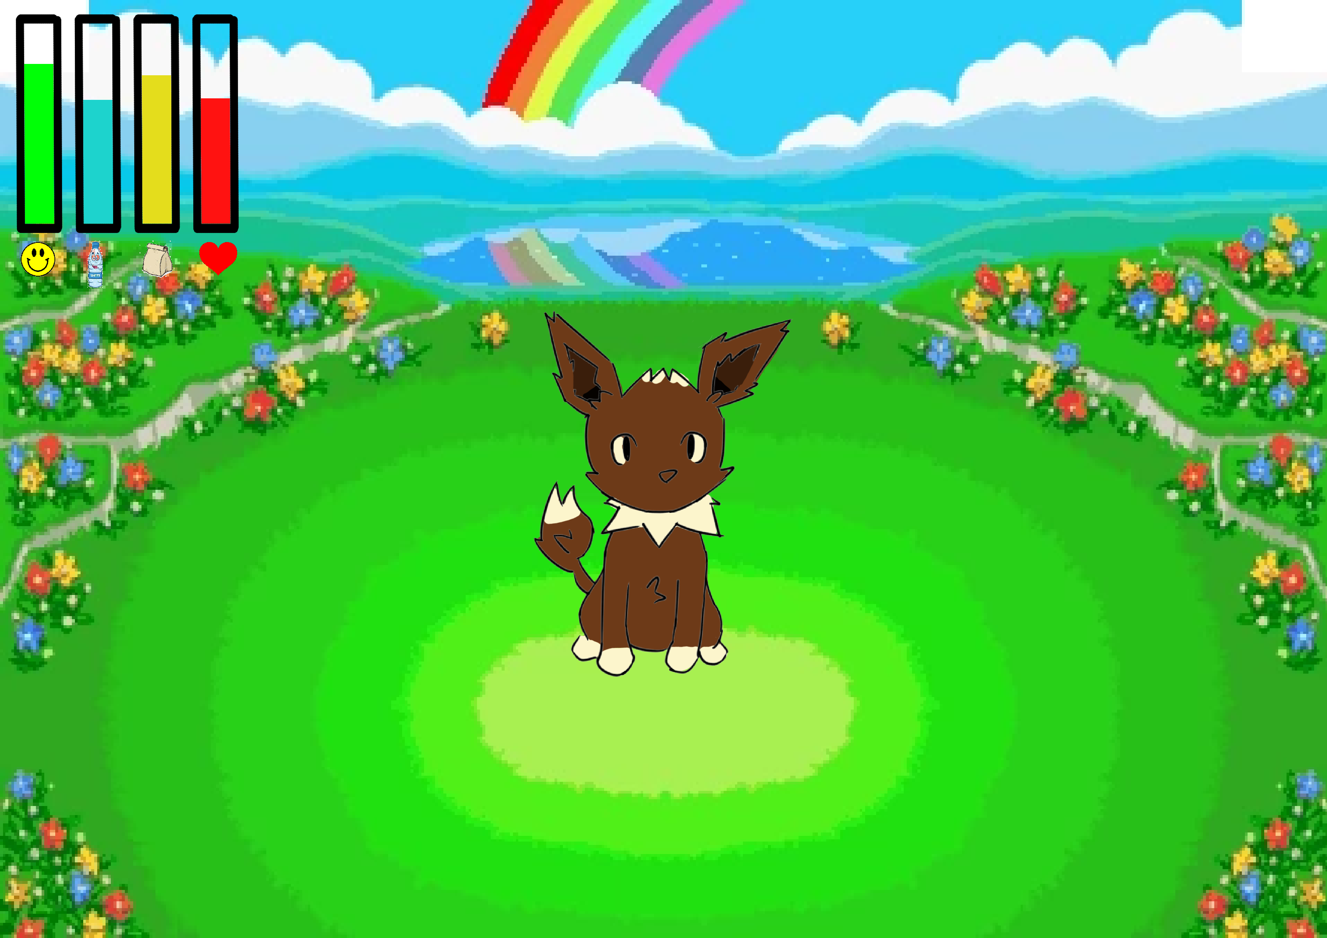
Mock Ups
TS

Slide 10
Any Questions?

